Slide 1

AI-BASED INTRUSION DETECTION SYSTEM (AI-IDS) WITH ENSEMBLE LEARNING AND ACTIVE DEFENSE
Guided By:
Dr. Veena S
Professor And Chairperson
Department Of Computer Applications
Presented By:
Name : Chaithanya S
SRN : PES1PG24CA233

Slide 2

CONTENT
Abstract
Introduction (Problem Scenario, Proposed Solution , Purpose, Scope)
Detailed Literature Survey
Tools & Technologies used.
Functional Requirements
Non-Functional Requirements
Design
References
Implementation

Slide 3
ABSTRACT
The rise of sophisticated cyber threats has exposed the limitations of conventional Intrusion Detection Systems (IDS), which primarily rely on static, signature-based methods. These approaches are ineffective against zero-day attacks and advanced persistent threats. To address this challenge, this project presents an AI-driven IDS that leverages both machine learning and deep learning techniques for accurate and adaptive threat detection.

Slide 4
INTRODUCTION
PROBLEM SCENARIO:
Today’s networks face rapidly evolving threats such as DDoS, port scans, brute-force attempts, and AI-powered malware.
Traditional rule-based IDS systems cannot keep up with new attack variants, resulting in delayed detection and high false positives.
PROPOSED SOLUTION:
AI-Based Intrusion Detection System (IDS) — a unified, intelligent security model that uses machine learning and real-time traffic analysis to detect both known and unknown attacks.
The system combines:
ML-based threat classification
Real-time packet/flow monitoring
Alerting + dashboard visualization.

Slide 5
INTRODUCTION
PURPOSE:
To develop a smart IDS that can automatically analyze network traffic, detect intrusions with high accuracy, and provide real-time alerts, improving security responsiveness and reducing false positives.
SCOPE:
The project is a security application featuring three core modules:
  1. Real-Time Traffic Monitoring
  2. AI-Based Detection Engine
  3. Alert & Visualization Dashboard

Slide 6
LITERATURE SURVEY
Title: AI-IDS: Application of Deep Learning to Real-Time Web Intrusion Detection.
Authors: Aechan Kim , Mohyun Park, And Dong Hoon Lee.
Published In: April 10, 2020, date of current version April 24, 2020.
Highlights:
Proposes a CNN-LSTM–based AI-IDS for real-time detection of web intrusions on large-scale traffic.
Uses Normalized UTF-8 encoding for fast HTTP request/payload preprocessing.
Trained on public + real-time datasets, aiming to detect obfuscated attacks and deployed using Docker for scalability.
Relevance to AI-IDS:
Highly relevant due to its deep learning + real-time detection focus.
Directly supports sequence-model component for payload analysis.
Offers insights into handling large-scale, real-time web traffic.

Slide 7
LITERATURE SURVEY
Title: An Enhanced AI-Based Network Intrusion Detection System Using Generative Adversarial Networks.
Authors: Cheolhee Park , Jonghoon Lee , Youngsoo Kim, Jong-Geun Park.
Published In: Ieee Internet Of Things Journal, Vol. 10, No. 3, 1 February 2023
Highlights:
Uses BEGAN (Boundary Equilibrium GAN) to generate synthetic samples for rare/minor attack classes to fix data imbalance. Augments training data for models like DNN, CNN, LSTM with an Autoencoder for feature extraction.
Proposed models (G-DNN_AE, G-CNN_AE) significantly improve detection of rare and zero-day style attacks across multiple datasets.
Relevance to AI-IDS:
Extremely relevant due to use of Autoencoders + anomaly detection, matching the hybrid design.
Validates integrating a non-traditional model to detect unknown/rare threats.
Strong evidence supporting advanced ML-based data augmentation in IDS.

Slide 8
LITERATURE SURVEY
Title: AI-Based Intrusion Detection System for Secure AI BOX Applications
Authors: Jiann-Liang Chen, Zheng-Zhun Chen, Youg-Sheng Chang.
Published In: 2023 International Conference on Artificial Intelligence in Information and Communication.
Highlights:
Uses ExtraTreesClassifier for fast and accurate (99%) intrusion detection on the ITRI AI BOX embedded device.
Features extracted using CICFlowmeter, with preprocessing steps like normalization, label encoding, and imbalance handling.
Runs on an embedded environment built with the Yocto Project.
Relevance to AI-IDS:
High relevance due to strong focus on feature engineering + supervised classifiers.
Supports use of ensemble models for network intrusion detection.
Aligns with supervised classification module.

Slide 9
LITERATURE SURVEY
Title: Development of AI-based Intrusion Detection System with Real-Time Flow Feature Extraction
Authors:Giwon Sur, Hyejin Kim, Seunghyun Yoon, and Hyuk Lim.
Published In:2023 IEEE International Conference on Big Data (BigData).
Highlights:
Addresses real-time IDS challenges by balancing inspection speed vs. flow feature extraction complexity.
Uses parallel traffic monitors + GPU servers (RTX 4090) to capture traffic and extract features simultaneously.
Achieves 2,800 flows/sec using tcpdump + CICFlowmeter and an MLP model for inference.
Relevance to AI-IDS:
Highly relevant for real-time processing and architecture design.
Supports the need for efficient flow-based feature extraction.
Aligns with focus on live traffic handling.

Slide 10
LITERATURE SURVEY
Title: AI-Driven Real-Time Network Intrusion Detection using Machine Learning and Deep Learning
Authors: Vivek Bagmar, Divyanshu Joshi.
Published In: 2025 3rd International Conference on Self Sustainable Artificial Intelligence Systems (ICSSAS)
Highlights:
Proposes a real-time NIDS using a binary classifier (Normal vs Anomalous) derived from key heuristics like srv_serror_rate and rerror_rate.
Compares NN, KNN, RF, and Naive Bayes, with Random Forest achieving 99.80% accuracy.
Confirms ensemble models as best-performing for real-time detection.
Relevance to AI-IDS:
Extremely relevant for ML/DL-based real-time classifier module.
Supports using Random Forest + Neural Networks as primary classifiers.
Reinforces real-time detection strategy.

Slide 11
LITERATURE SURVEY
Title: Artificial Intelligence-Based Intrusion Detection and Prevention in Edge-Assisted SDWSN With Modified Honeycomb Structure.
Authors: Joseph Kipongo, Theog. Swart And Ebenezer Esenogho .
Published In: 28 December 2023,IEEE.
Highlights:
Proposes a full security framework for SDWSN, including authentication, clustering, and RL-based routing (TLDQN).
Core IDS uses a Hybrid approach: DTO-based malicious node detection + Bi-GAN for intrusion detection.
Designed for high accuracy and scalability, supported by a hierarchical multi-blockchain structure.
Relevance to AI-IDS:
Highly relevant due to its Hybrid + GAN-based IDS model, similar to architecture.
Demonstrates advanced AI integration in distributed/edge environments.
Supports the use of deep learning + anomaly generation techniques.

Slide 12
LITERATURE SURVEY
Title: AI-based Techniques for Network-based Intrusion Detection System: A Review.
Authors: Yudhir Gala, Nisha Vanjari, Dharm Doshi, Inshiya Radhanpurwala.
Published In: 2023 10th International Conference on Computing for Sustainable Global Development.
Highlights:
Comprehensive survey of ML & DL models used in NIDS (SVM, AE, LSTM, GANs, etc.).
Notes a strong shift toward deep learning and hybrid approaches for better feature extraction and accuracy.
Highlights key challenges: class imbalance, outdated datasets, and need for real-time performance.
Relevance to AI-IDS:
Highly relevant as a literature foundation validating architectural choices.
Supports use of LSTM, AE and Hybrid Models.
Confirms alignment with current research trends.

Slide 13
LITERATURE SURVEY
Title: Artificial Intelligence based Intrusion Detection Systems.
Authors: Vignesh Reddy, Sunitha R, M. Anusha .
Published In: 2024 4th International Conference on Mobile Networks and Wireless Communications.
Highlights:
Surveys AI-based IDS techniques with emphasis on IoT and heterogeneous networks.
Concludes that Bi-LSTM and GANs perform best in complex, dynamic traffic, while ensemble models improve robustness.
Supports hybrid DL + ML designs to reduce latency and computational cost.
Relevance to AI-IDS:
Highly relevant for model justification in architecture.
Validates use of Bi-LSTM and ensemble classifiers.
Supports system’s mixed-model approach.

Slide 14
LITERATURE SURVEY
Title: Artificial Intelligence-Powered Network Intrusion Detection System (IDS) with Hybrid Deep Learning Approach in Cloud Environments.
Authors: Akshay Sharma, Bhushan Balkrishna Chaudhari, Satish Kabade.
Published In: 2025, IEEE North-East India International Energy Conversion Conference and Exhibition.
Highlights:
Proposes a real-time cloud NIDS using a hybrid LSTM-Petri Net (LSTM-PNet) model for better temporal analysis + structured decision-making.
Uses CSE-CIC-IDS2018 with strong preprocessing and PCA for dimensionality reduction.
Achieves 99.68% accuracy, outperforming DT, DNN, CNN, and MLP-PSO models.
Relevance to AI-IDS:
Highly relevant due to its hybrid deep learning + sequence modeling approach.
Supports focus on real-time, high-accuracy IDS design.
Validates feature engineering techniques like PCA.

Slide 15
LITERATURE SURVEY
Research paper | Core Applications/Focus | Related to My Project
AI-IDS: Application of Deep Learning to Real-Time Web Intrusion Detection (A. Kim et al., 2020). | Real-Time Web Traffic at Big Data scale (HTTP requests). | Architectural Blueprint: Provides a validated model (CNN-LSTM) specifically for real-time HTTP web attacks (unknown/obfuscated). It is implemented using Docker for scalability, directly supporting your "live traffic" goal.
Development of AI-based IDS with Real-Time Flow Feature Extraction (G. Sur et al., 2023) | Real-Time Flow Feature Extraction (2,800 flows/sec) via parallel monitors and GPU servers. | Feature Engineering & Scalability: Validates the technical feasibility of high-throughput, real-time feature extraction from live traffic using parallel hardware and CICFlowmeter.
AI-Driven Real-Time NIDS... in Cloud Environments Ci(A. Sharma et al., 2025) | Real-Time NIDS for Cloud Environments. | Context and Benchmarking: Emphasizes the critical need for real-time, high-accuracy NIDS in dynamic cloud environments. This reinforces the importance of your solution for modern infrastructures.

Slide 16
LITERATURE SURVEY
Research Paper | Core ML Model & Result | Related to My Project
AI-Driven Real-Time NIDS using ML and DL (V. Bagmar, 2025) | Random Forest (RF): Achieved 99.80% Accuracy. | ML Classifier Validation: Strongly validates Random Forest as the optimal ML classifier (outperforming NN and KNN) for a real-time, high-accuracy component against anomalous behavior.
AI-Based IDS for Secure AI BOX Applications (J. Chen et al., 2023) | Extremely Randomized Trees (ensemble/variant of RF): Achieved 99% accuracy. | ML Classifier Validation: Further reinforces the selection of ensemble classifiers (like RF/XGBoost) for achieving high-accuracy, efficient detection on embedded/real-time systems.
AI-based Techniques for NIDS: A Review (Y. Gala et al., 2023) | Review of SVM. | Hybrid Rationale: Supports the common hybrid approach where ML models (like SVM or RF) handle the final classification task after a deep learning model performs feature extraction.

Slide 17
LITERATURE SURVEY
Research Paper | Core DL/Anomaly Model | Related to My Project
An Enhanced AI-Based NIDS Using GANs (C. Park et al., 2023) | GANs (BEGAN) combined with Autoencoders (AE) for feature extraction. | Unknown Attack Detection: Provides the most direct evidence for using GANs/AEs to solve data imbalance and augment training to detect rare/minor attacks (mimicking unknown threats).
AI-Driven Real-Time NIDS... with Hybrid Deep Learning (A. Sharma et al., 2025) | LSTM-Petri Net (PNet). | Sequence Model Innovation: Validates the use of LSTM to capture temporal patterns in traffic, showing how it can be enhanced with supplementary methods (like Petri Nets) to improve structured decision-making.
AI-based Intrusion Detection Systems (V. Reddy et al., 2024) | Bi-LSTM and GANs. | Model Justification: Concludes that Bi-LSTM and GANs are best for tackling dynamic, complex data streams, directly justifying their inclusion as the adaptive/anomaly-detecting component of your hybrid system.

Slide 18
TOOLS AND TECHNOLOGIES
Language & notebook: Python(3.11.7)
Data handling: pandas(2.2.2), numpy(1.26.4)
ML/Deep Learning: scikit-learn(1.5.1), XGBoost(2.0.3), TensorFlow(2.15.0).
Packet capture / replay: Scapy(2.5.0), pyshark(0.6.0).
Model serving / API: Flask(3.0.2).
Dashboard / frontend: plain HTML/CSS/Bootstrap(5.3.2) + Chart.js(4.4.1).
Visualization: matplotlib(3.8.2), Plotly.js(2.30.0) (frontend).
Live Communication: Flask-SocketIO (5.3.6) / WebSockets for instant threat pushing.
Storage of logs: MySQL .
Closing the Security Gap 🔗: Address both technical malware and the advanced social engineering tactics used in modern attacks.
Shifting to Proactive Defense 🏃‍♂️: Move from a reactive model to a proactive one that stops attacks before they start.
Combating AI-Driven Threats 🤖: Tackle the emerging threat of deepfake images used for deception and fraud.
Empowering the User 💪: Transform the user from the "weakest link" into a strong first line of defense with advanced tools and training.
Contributing a Novel, Layered Solution 🧩: Design a hybrid defense model that combines technical and human-layer security for a more resilient system.

Slide 19
FUNCTIONAL REQUIREMENTS
1. Data Acquisition Module:
Collects raw network traffic from datasets (CICIDS2017) or PCAP files.
Supports live packet capture using Scapy/PyShark.
Stores traffic in a structured format for analysis and model training.
Ensures reliable and continuous data input to the IDS pipeline.
2. Preprocessing & Feature Engineering Module:
Cleans raw traffic (removes null/invalid values).
Extracts statistical features like packet count, byte rate, flags, durations.
Normalizes and transforms data for machine learning models.
Encodes labels for supervised training (Normal vs Attack classes).
3. Machine Learning Model Training Module:
Trains ML models such as Random Forest, CNN/LSTM, Autoencoder.
Splits data into training/testing sets and evaluates performance.
Tunes hyperparameters to improve detection accuracy.
Saves the trained model and scaler for real-time inference.

Slide 20
FUNCTIONAL REQUIREMENTS
4. Real-Time Intrusion Detection Module
Accepts live traffic windows and extracts features in real time.
Uses the trained ML model to classify traffic as normal or malicious.
Assigns confidence scores and severity levels.
Works continuously to provide fast, accurate detection.
5. Alert Generation & Management Module
Creates alerts when suspicious or malicious activity is detected.
Captures details such as IPs, timestamps, attack type, confidence score.
Stores alerts in a database (MySQL) for auditing.
Feeds alert data to dashboard and visualization modules.
6. Monitoring Dashboard Module
Displays live alerts, attack types, and traffic statistics.
Provides visualizations using charts and tables.
Allows security analysts to monitor threats in real time.
Retrieves data through API calls to the IDS backend.

Slide 21
FUNCTIONAL REQUIREMENTS
7. Attack Simulation Module
Generates artificial attacks (DoS, Port Scan, Brute-force) for testing.
Allows replaying PCAP files to simulate realistic attack traffic.
Helps validate model performance and system accuracy.
Useful for demos, evaluation, and training new models.
8. Active Defense & Mitigation Module:
Programmatically executes firewall rules to block high-confidence threats.
Leverages Windows Defender Firewall via Netsh and PowerShell commands.
Provides an automated response to isolate malicious IPs in real-time.
Prevents potential damage by terminating connections from verified attackers.
9. Explainable AI (XAI) Insight Module:
Visualizes feature contribution scores using interactive radar charts.
Provides transparency into why a specific flow was classified as malicious.
Bridges the gap between complex model outputs and human decision-making.
Helps security analysts verify the legitimacy of high-confidence alerts.

Slide 22
NON-FUNCTIONAL REQUIREMENTS
1. Performance (Real-Time Speed)
Low Latency: Detection-to-Alert time is < 50ms, ensuring instantaneous updates.
High Throughput: Capable of processing packets in < 10ms, suitable for live traffic monitoring.
Reactive UI: Dashboard updates via WebSockets (Socket.IO) eliminate the need for page refreshing.
2. Reliability & Resilience
Dual-Engine Fallback: If the primary classifier is uncertain, the system automatically switches to the Autoencoder for anomaly analysis.
Self-Healing: Automated connection handling for the dashboard stream ensures stability during network jitters.
3. Usability & Experience (UX)
Explainable AI (XAI): Complex mathematical risks are converted into readable visualizations (Radar Charts).
Critical Signaling: Immediate visual cues (Glitch Effects, Red Borders) prioritize "Zero-Day" threats over routine noise.

Slide 23
NON-FUNCTIONAL REQUIREMENTS
4. Security & Safety
Automated Containment: The system acts faster than a human by automatically quarantining high-risk IPs.
Forensic Auditing: Every anomaly is cryptographically logged with a timestamp and raw feature vector for post-incident review.
Access Control: Dashboard is secured via Login Authentication to prevent unauthorized access.
5. Detection Precision (Quality Attribute)
High Fidelity: The system must maintain a False Positive Rate (FPR) of < 0.5% for normal traffic to prevent alert fatigue for analysts.
Confidence Thresholds: Alerts are only escalated to "Critical" status if the AI Confidence Score exceeds 85%, ensuring actionable intelligence.
Consistency: The model outputs must be deterministic; reprocessing the same packet capture must yield the exact same classification result every time.

Slide 24
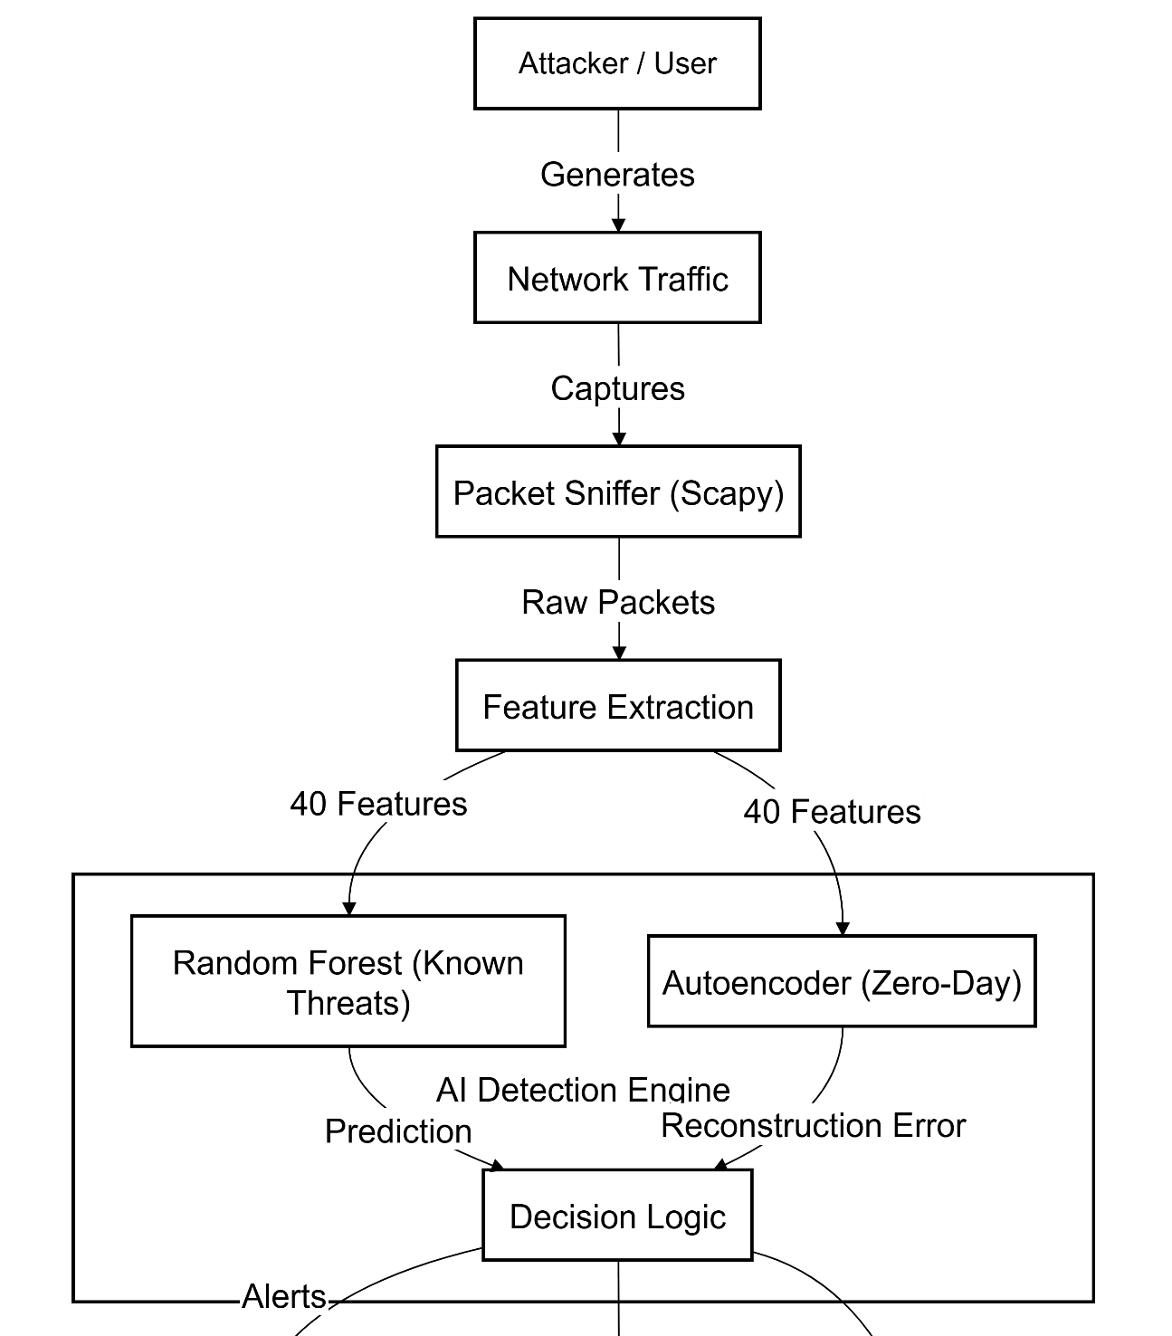

DESIGN-ARCHITECTURE DIAGRAM

Slide 25
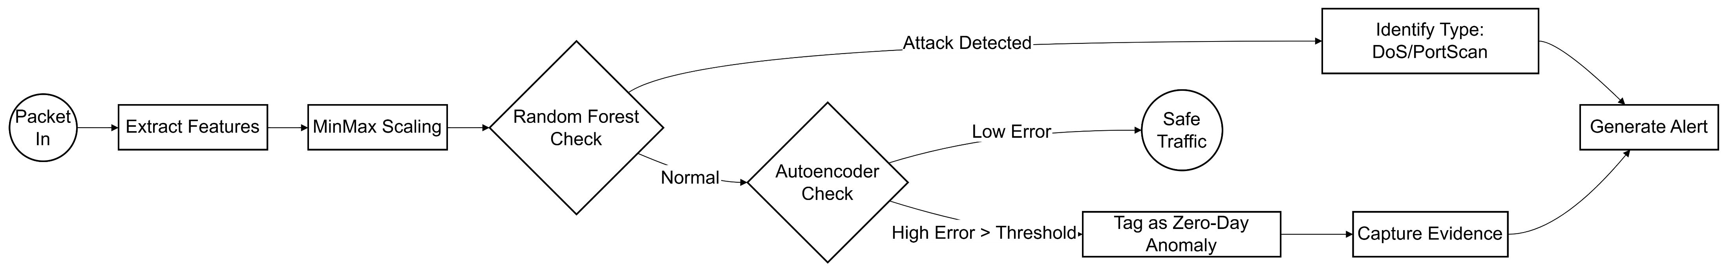
ML -PROCESS FLOW DIAGRAM

Slide 26
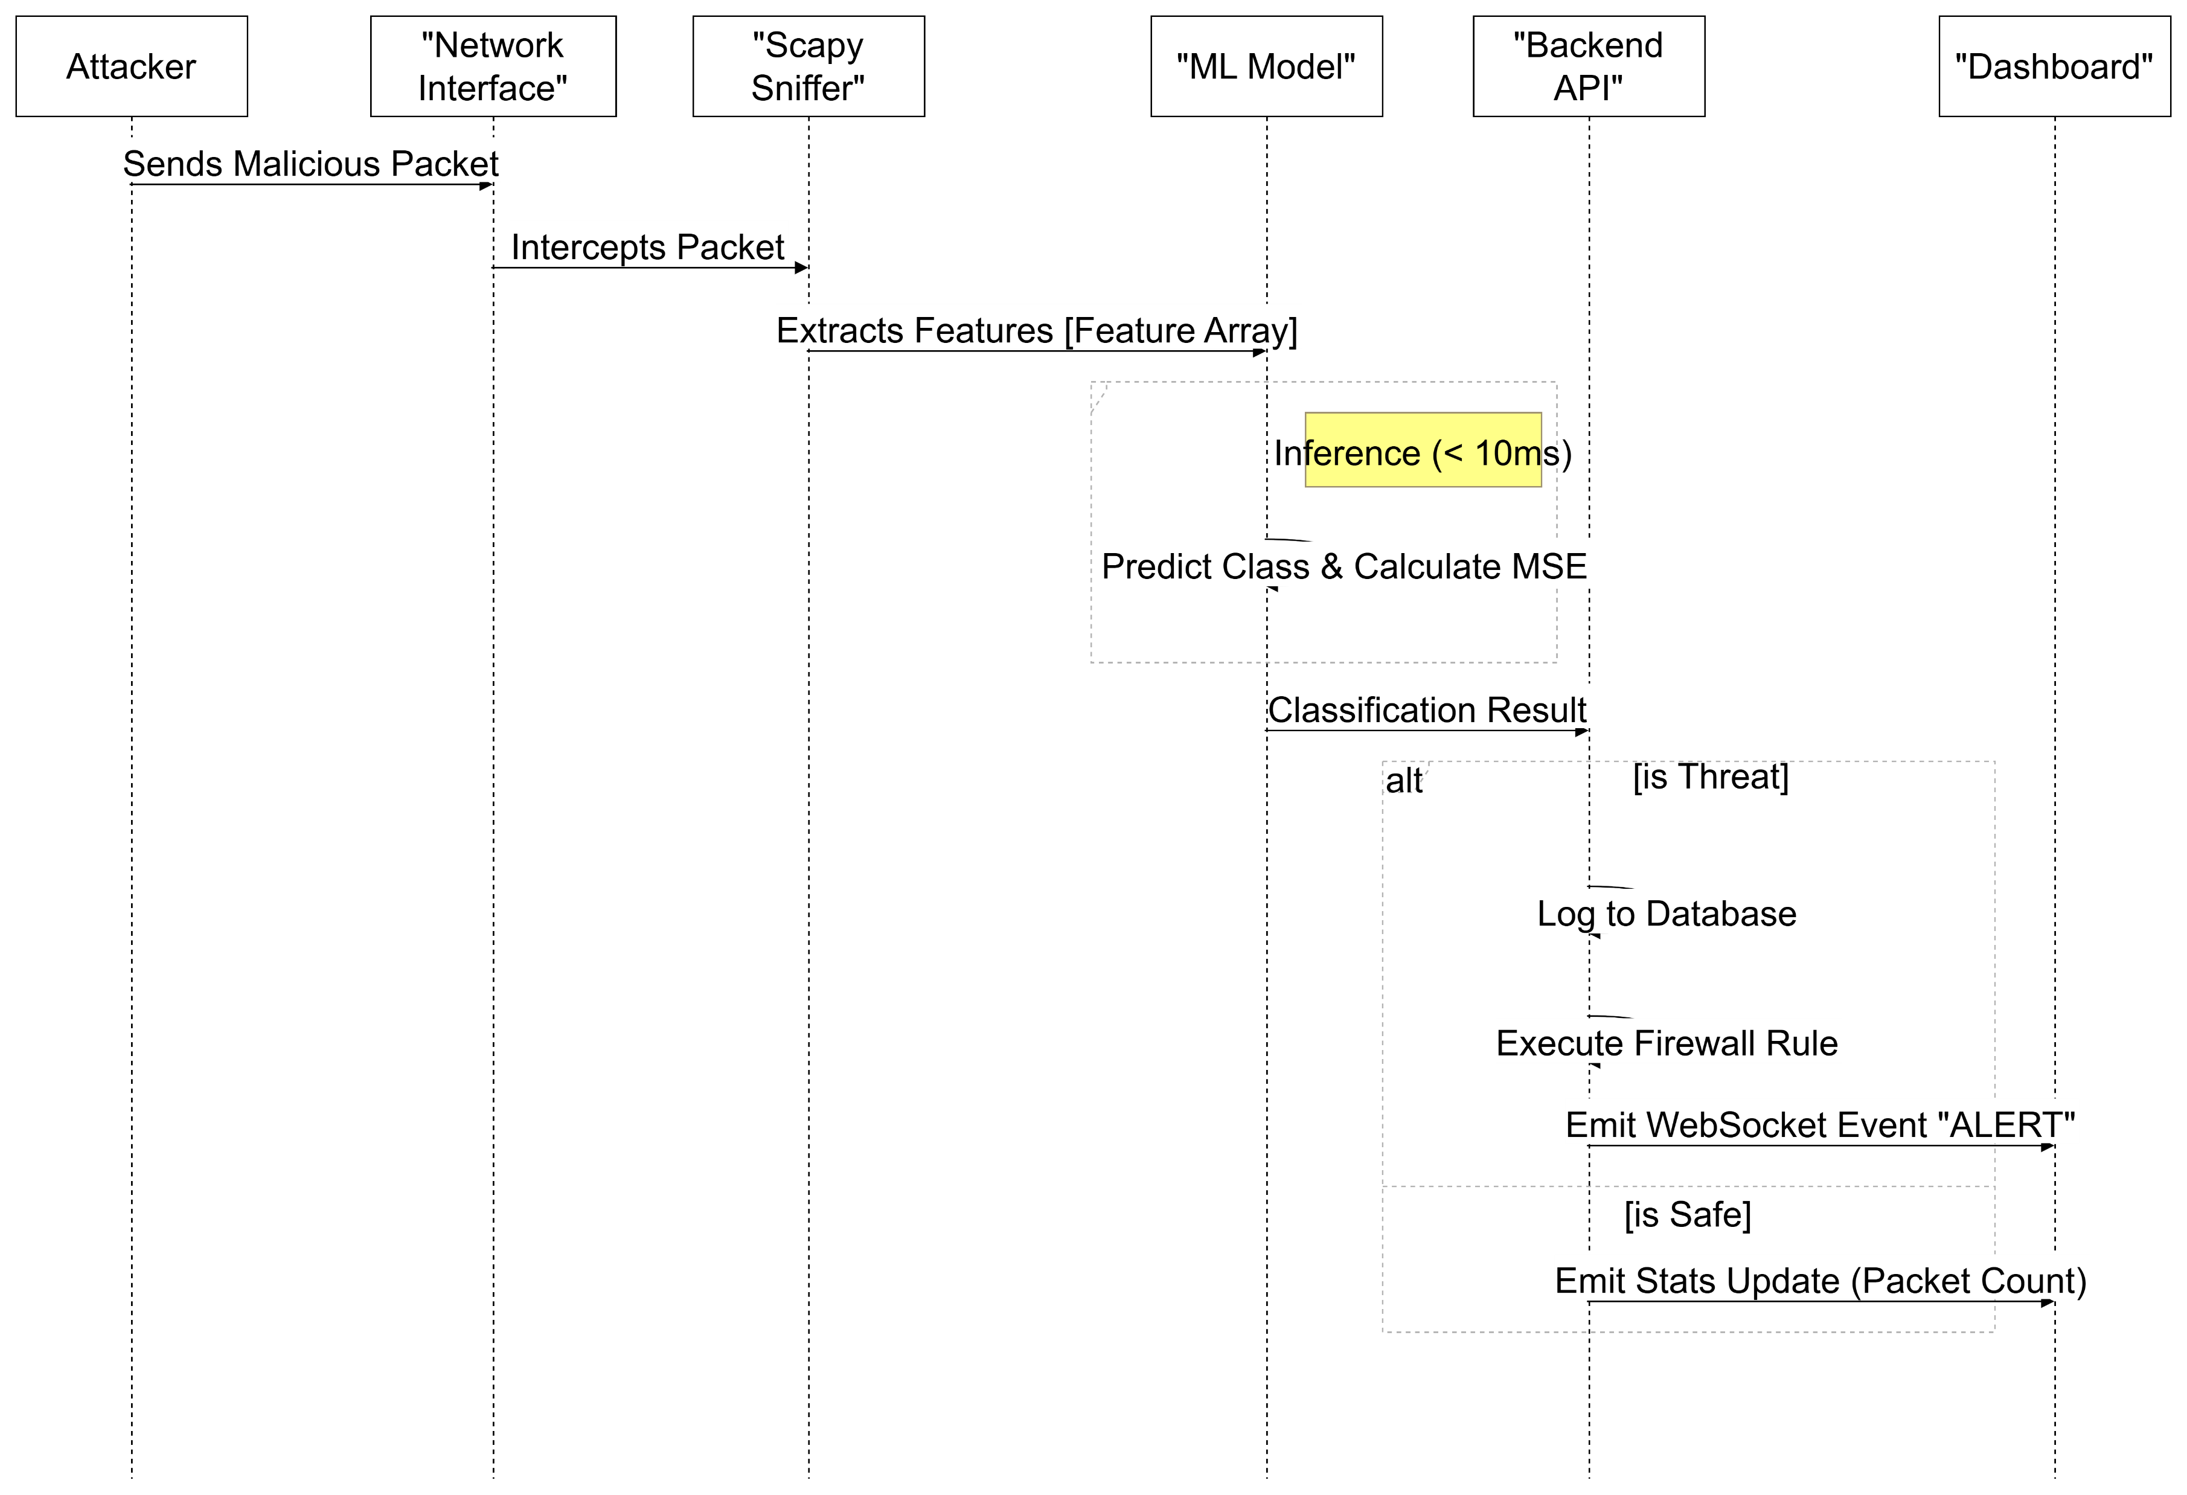
NETWORK PROCESS FLOW DIAGRAM

Slide 27
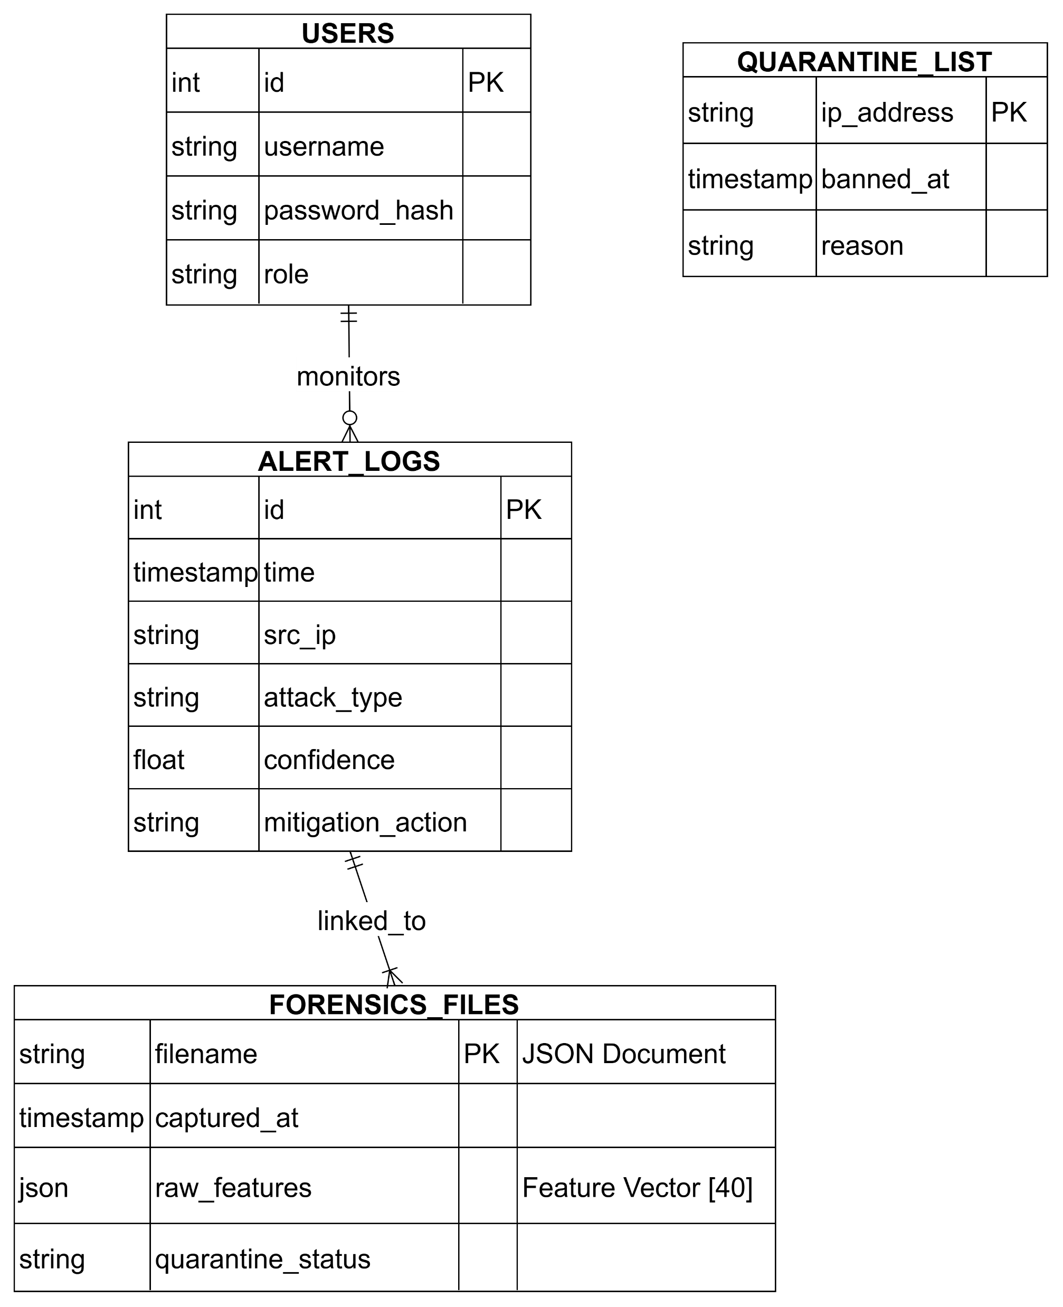
DATABASE/DATA SCHEMA DESIGN

Slide 28
BACKEND CORE & ANALYSIS ENGINE (app.py) –
PSEUDOCODE
FUNCTION Analyze_Traffic(packet):
# 1. Feature Extraction
features = Extract_Features(packet)
# 2. Multi-Stage Detection
# Stage A: Known Attacks (Random Forest)
IF RandomForest.predict(features) IS ATTACK:
Trigger_Alert("Known Signature Detected")
# Stage B: Unknown/Zero-Day (Autoencoder)
ELSE IF Autoencoder.Error(features) > THRESHOLD:
Trigger_Alert("Zero-Day Anomaly Detected")
# 3. Automated Response
IF Alert_Triggered:
Block_Source_IP(packet.src)
Save_Forensic_Evidence()
SocketIO.Emit("Real-Time Dashboard Update")
ELSE:
Allow_Traffic()
"The Backend Core is the central nervous system of our project. It ingests the data, runs it through our Hybrid AI models, and makes the critical decision to block or monitor traffic. It also ensures the analyst dashboard is always in sync with real-time network events."

Slide 29
MODEL TRAINING PIPELINE (train_model.py) MODULE - PSEUDOCODE
FUNCTION Train_Hybrid_Models():
# 1. Prepare Data
data = Load_CICIDS2017_Dataset()
data = Balance_And_Normalize(data)
# 2. Train Supervised Identifier (Random Forest)
RF_Model.train(data, labels=["Benign", "DoS", "PortScan", ...])
Save(RF_Model)
# 3. Train Unsupervised Detector (Autoencoder)
# Train only on Benign data to learn "Normality"
Autoencoder.train(data[Benign_Only])
Save(Autoencoder)
# 4. Train Sequence Detector (CNN-LSTM)
CNN_LSTM.train(Time_Series_Reshaped(data))
Save(CNN_LSTM)
"This is the 'School' for our AI. We take massive historical datasets, clean and balance them, and train our three distinct models. This offline process ensures that when the system goes live, it already 'knows' what a threat looks like."

Slide 30
PACKET SNIFFER / INGESTION AGENT (sniffer.py) MODULE - PSEUDOCODE
FUNCTION Capture_And_Send():
WHILE True:
packet = Sniff_Interface()
if packet.is_IP:
# Convert raw bytes to ML features (40 dimensions)
features = Feature_Extraction(packet)
# Send to Backend for processing
payload = { "ip": packet.src, "features": features }
HTTP_POST(Backend_URL, payload)
"Sitting on the network edge, the Sniffer is our lightweight agent. It filters out noise and captures only relevant IP traffic, ensuring that our heavy AI models are fed clean, structured data without slowing down the network."

Slide 31
FEATURE EXTRACTOR (src/feature_extraction.py) MODULE - PSEUDOCODE
FUNCTION Extract(packet):
# Map packet to CICIDS2017 40-feature vector
vector = [0] * 40
vector[Pt] = packet.port; vector[Len] = packet.len
# Heuristic Projection (Single Pkt -> Flow)
IF packet.SYN: vector[Duration] = HIGH_VAL # Sim DoS
IF packet.FIN: vector[Duration] = LOW_VAL # Sim Scan
RETURN vector
"AI deals in numbers, not bytes. The Feature Extractor bridges this gap, instantly translating raw network traffic into the 40-dimensional vector format our models were trained on, using smart heuristics to estimate complex flow statistics in real-time."

Slide 32
ATTACK SIMULATOR (attack_simulation.py) MODULE - PSEUDOCODE
FUNCTION Simulate_Attacks():
ATTACKS = ["DoS", "PortScan", "BruteForce", "WebAttack", "Botnet"]
WHILE True:
# Pick a random attack scenario
type = Random_Choice(ATTACKS)
# Generate traffic with specific signatures
IF type == "DoS":
features = Generate_High_Volume_Traffic()
ELSE IF type == "PortScan":
features = Generate_Rapid_Connection_Attempts()
# Fire at IDS Backend to test detection
Send_Traffic(Target_IP, features)
Sleep(Random_Interval)
"To prove our system works without exposing us to real danger, we built this Simulator. It creates sophisticated, randomized attack patterns that look exactly like real threats, allowing us to validte our detection accuracy on demand."

Slide 33
DASHBOARD FRONTEND (dashboard.html) MODULE - PSEUDOCODE
MODULE Dashboard_Frontend:
# 1. Establish Real-Time Link
Socket = Connect(Backend_URL)
# 2. Event Listeners
Socket.On("update_data", (data) => {
# Update KPI Cards
Update_DOM("confidence_val", data.ai_conf)
Update_DOM("packet_count", data.total_pkts)
# Visualize Threat in Charts
IF data.alert_type != "Safe":
TimelineChart.Add_Bubble(
time=data.timestamp,
y=data.confidence,
color=Get_Color_By_Type(data.alert_type)
)
# Animate Radar Chart (XAI)
RadarChart.Update_Dataset(data.xai_scores)
# Add to Feed Panel
Append_Log_Item(data.details, class="alert-anim")
})
FUNCTION On_Threat_Click(threat_id):
# Show specific mitigation details
Modal.Show(mitigation_steps[threat_id])
"Finally, the Dashboard is the face of our system. We moved beyond simple logs to create a cinematic, interactive interface. It doesn't just show 'Alerts'; it visualizes the threat landscape, helping analysts understand the 'Why' and 'How' behind every detection instantly."

Slide 34
DATABASE MANAGER (database.py) MODULE - PSEUDOCODE
CLASS Database:
FUNCTION Save_Alert(alert_data):
Lock_Thread() # Ensure data integrity
SQL_INSERT("INSERT INTO alerts VALUES (?)", alert_data)
Unlock_Thread()
FUNCTION Get_Dashboard_Feed():
# Fetch latest alerts for the UI
RETURN SQL_QUERY("SELECT * FROM alerts ORDER BY time DESC LIMIT 50")
"Security is about history as much as the present. Our Database Manager ensures that no alert is ever lost, handling high-speed simultaneous writes and providing a complete audit trail for forensic investigation."

Slide 35
DATABASE MANAGER (database.py) MODULE - PSEUDOCODE
CLASS Database:
FUNCTION Save_Alert(alert_data):
Lock_Thread() # Ensure data integrity
SQL_INSERT("INSERT INTO alerts VALUES (?)", alert_data)
Unlock_Thread()
FUNCTION Get_Dashboard_Feed():
# Fetch latest alerts for the UI
RETURN SQL_QUERY("SELECT * FROM alerts ORDER BY time DESC LIMIT 50")
"Security is about history as much as the present. Our Database Manager ensures that no alert is ever lost, handling high-speed simultaneous writes and providing a complete audit trail for forensic investigation."

Slide 36
Implementation Status
1: Foundation & Research.
  Extensive Literature Survey and Domain Analysis (Submitted).
  Finalized project architecture and core module design.
  Defined functional and non-functional requirements.
  Set up development environments (Python backend).
2: Core Functionalities.
Backend Core & Analysis Engine (app.py)
Status: Complete.
Features:
  Flask Server & API Enpoints active.
  WebSocket (Socket.IO) real-time link established.
  Hybrid AI Logic (Random Forest + Autoencoder) fully integrated.
  Active Defense (Firewall/Quarantine) logic verified (simulated mode).

Slide 37
Implementation Status
Intelligence Gathering (sniffer.py & feature_extraction.py) .
Status: Functional Prototype.
Features:
  Real-time packet capture via Scapy.
  Feature vectorization of 40 CICIDS2017 features.
  Note: Uses heuristic estimation for complex "Flow" features to ensure checking speed for the prototype.
AI Model Pipeline (train_model.py) .
Status: Complete.
Features:
  Scripts to process CICIDS2017 data and train/save all 3 models (RF, AE, CNN-LSTM).

Slide 38
Implementation Status
Frontend Dashboard (dashboard.html)
Status: Complete.
Features:
  "Glassmorphism" UI design implemented.
  Real-time charts (Bubble Timeline, XAI Radar, Traffic Line) active.
  Live Feed with visual indicators (Glitch effects) working.
  Responsive and interactive.
Data Persistence Layer (database.py) .
Status: Complete.
Features:
  MySQL connection handling with thread safety.
  Automatic table initialization.
  Session reset capability (Clear DB on startup) working.

Slide 39
Implementation Status
Testing & Validation (attack_simulation.py)
Status: Complete.
Features:
  Generates 6 distinct attack vectors (DoS, PortScan, BruteForce, etc.).
  Successfully triggers backend alerts for validation.
Active Defense & Prevention Module (IPS)
Status: Complete (Simulated Actions).
Features:
  Automated Blocking: Logic to trigger Windows Firewall rules (via netsh) for high-confidence threats (>80%).
  Quarantine Protocol: Logic to isolate "Botnet" infected hosts to a restricted list.
  Forensic Capture: Automatically saves full packet details to JSON logs for Zero-Day anomalies.

Slide 40
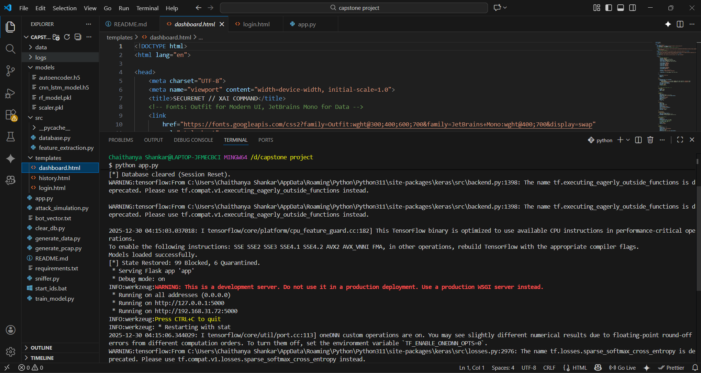
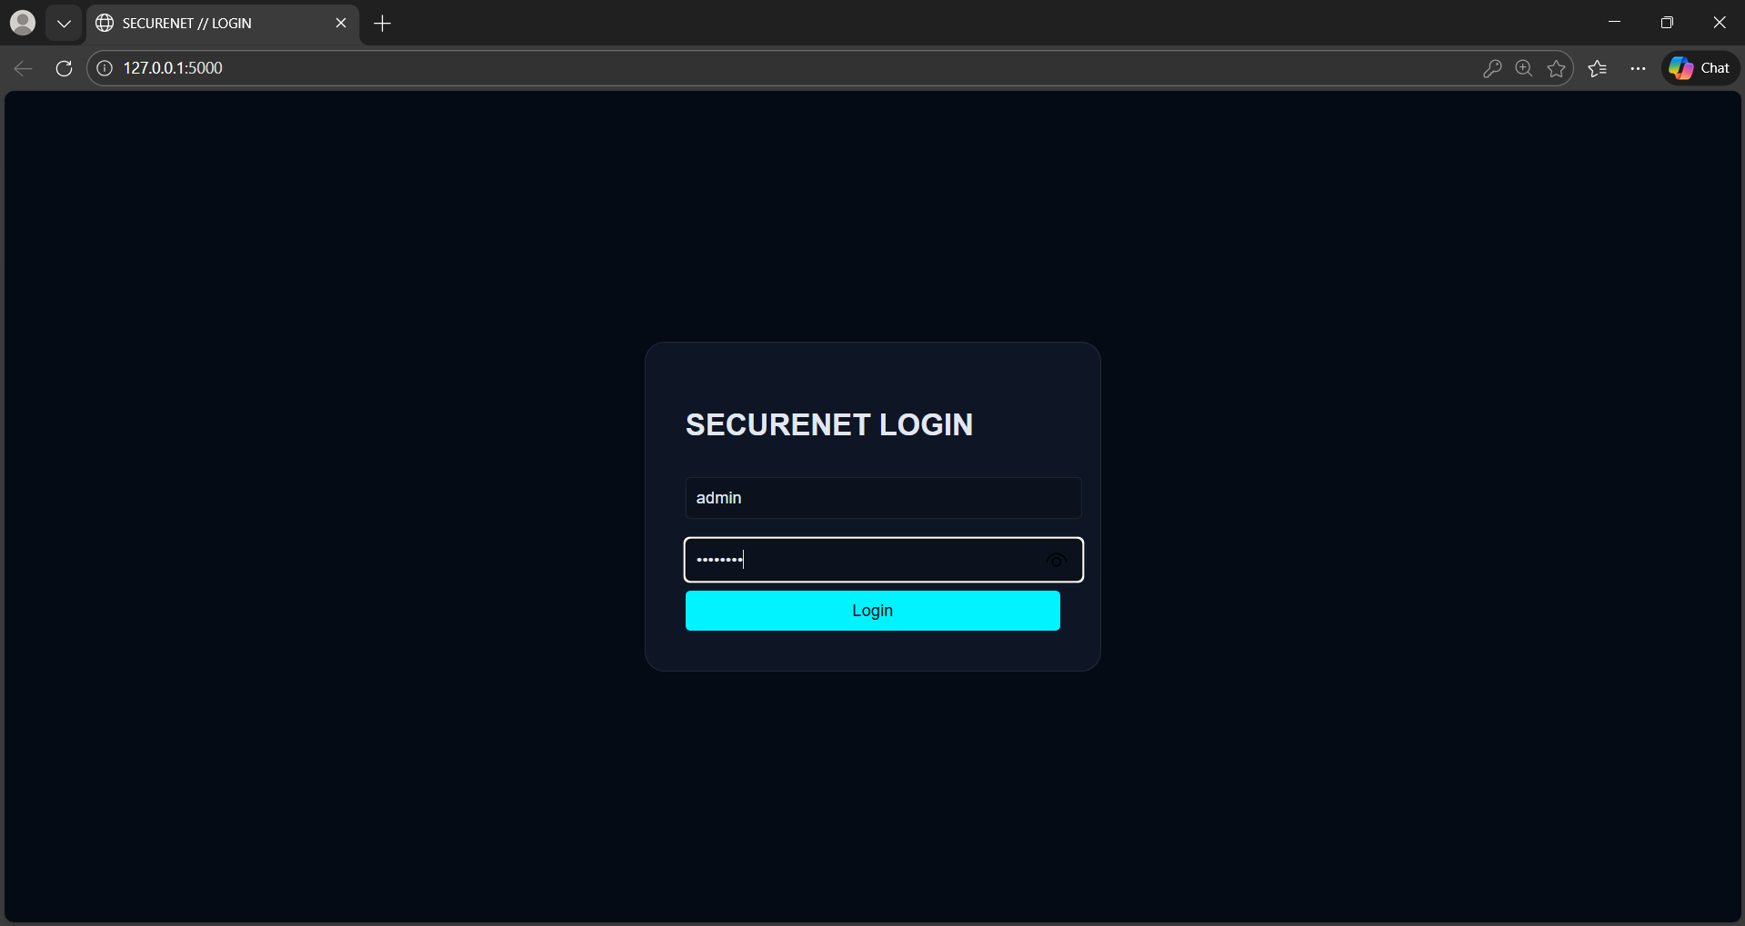
IMPLEMENTATION SCREENSHOTS
Fig 7.2.1 Initialization of project(app.py)
Fig 7.2.2 Login Page

Slide 41
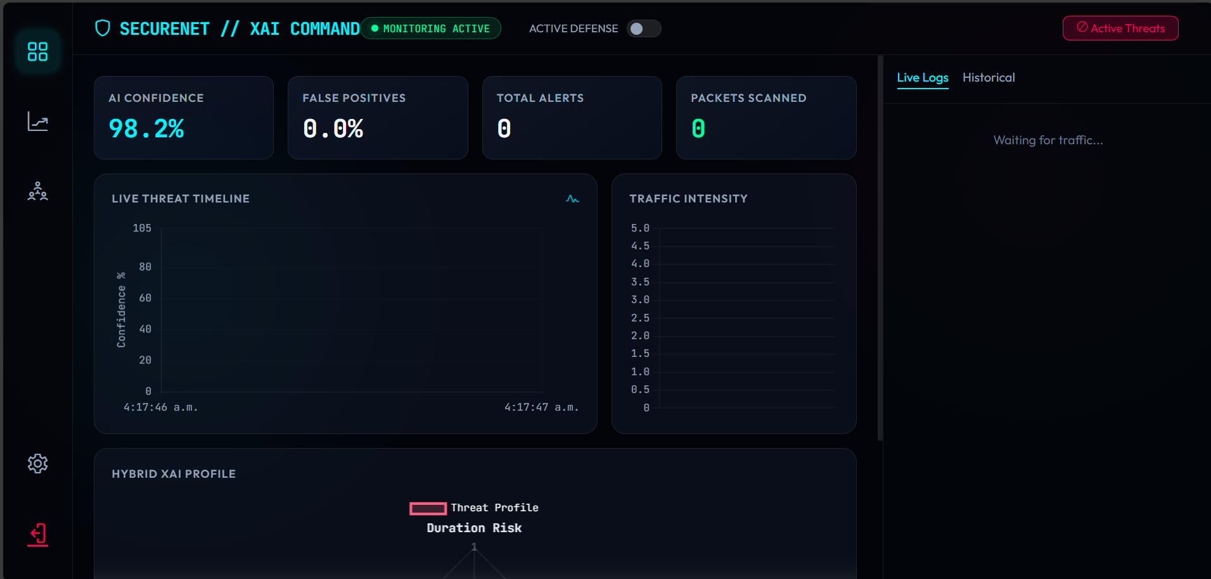
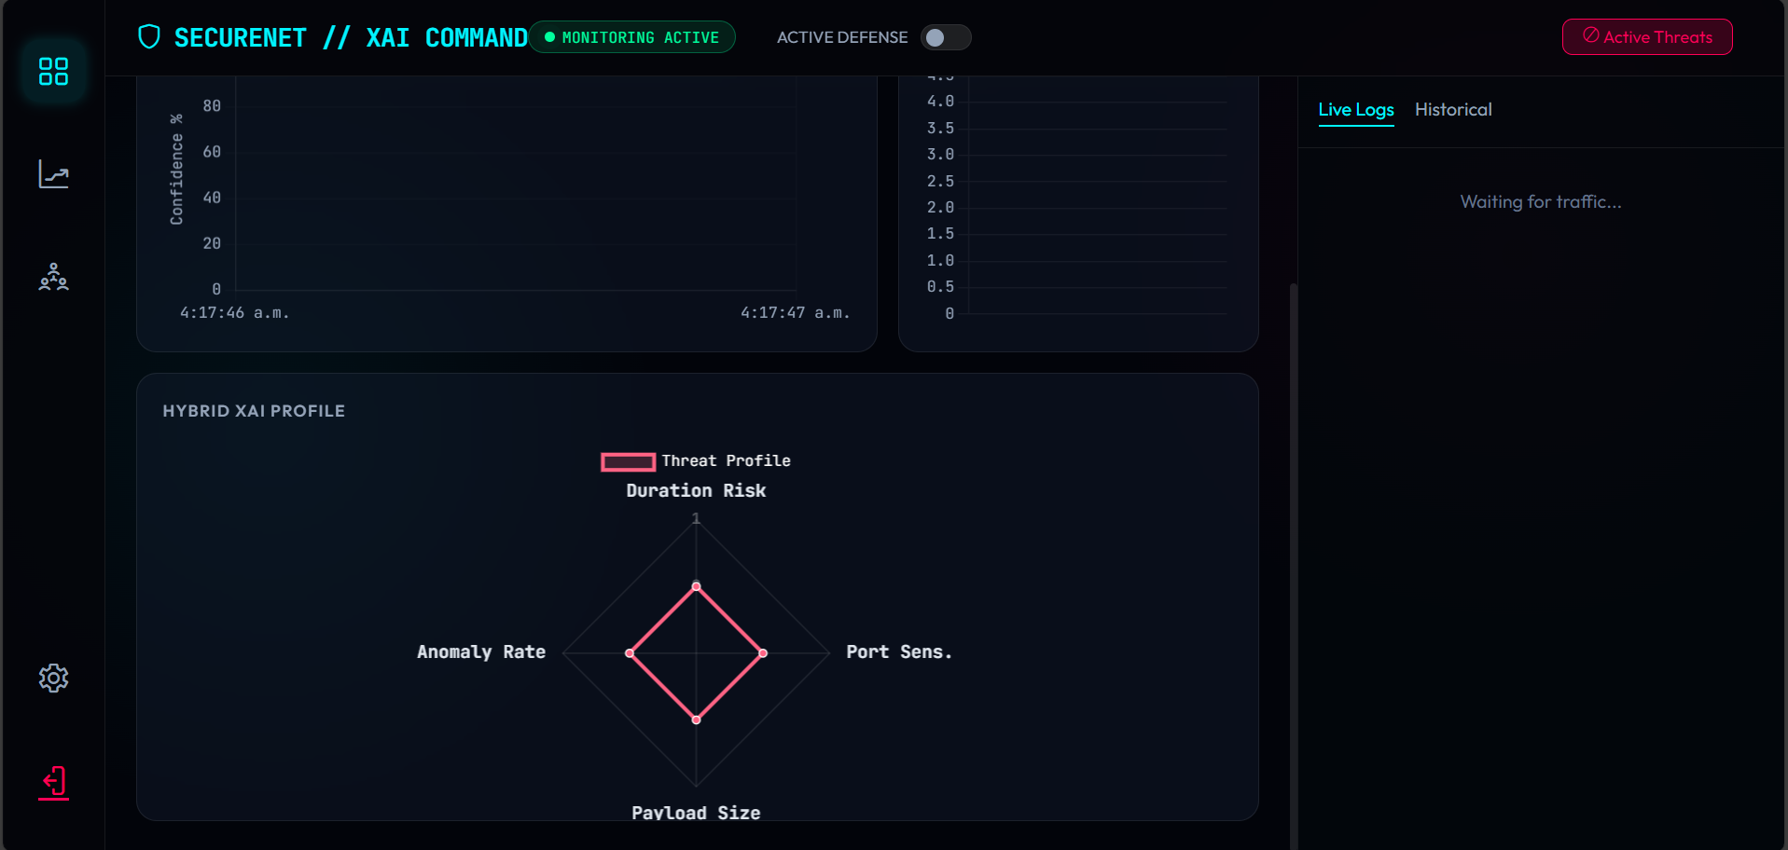
IMPLEMENTATION SCREENSHOTS
Fig 7.2.3 Dashboard Page-1
Fig 7.2.4 Dashboard Page-2

Slide 42
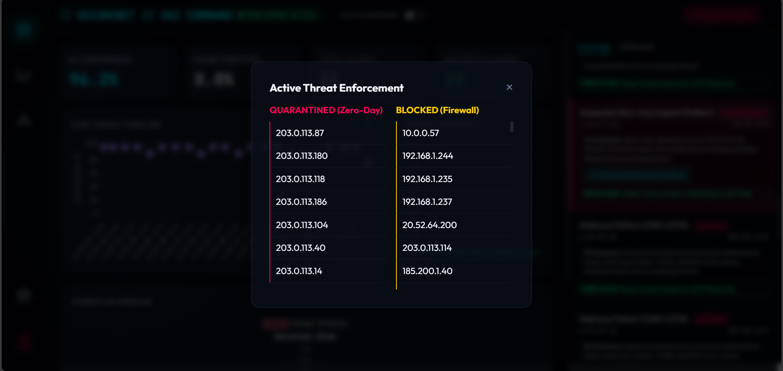
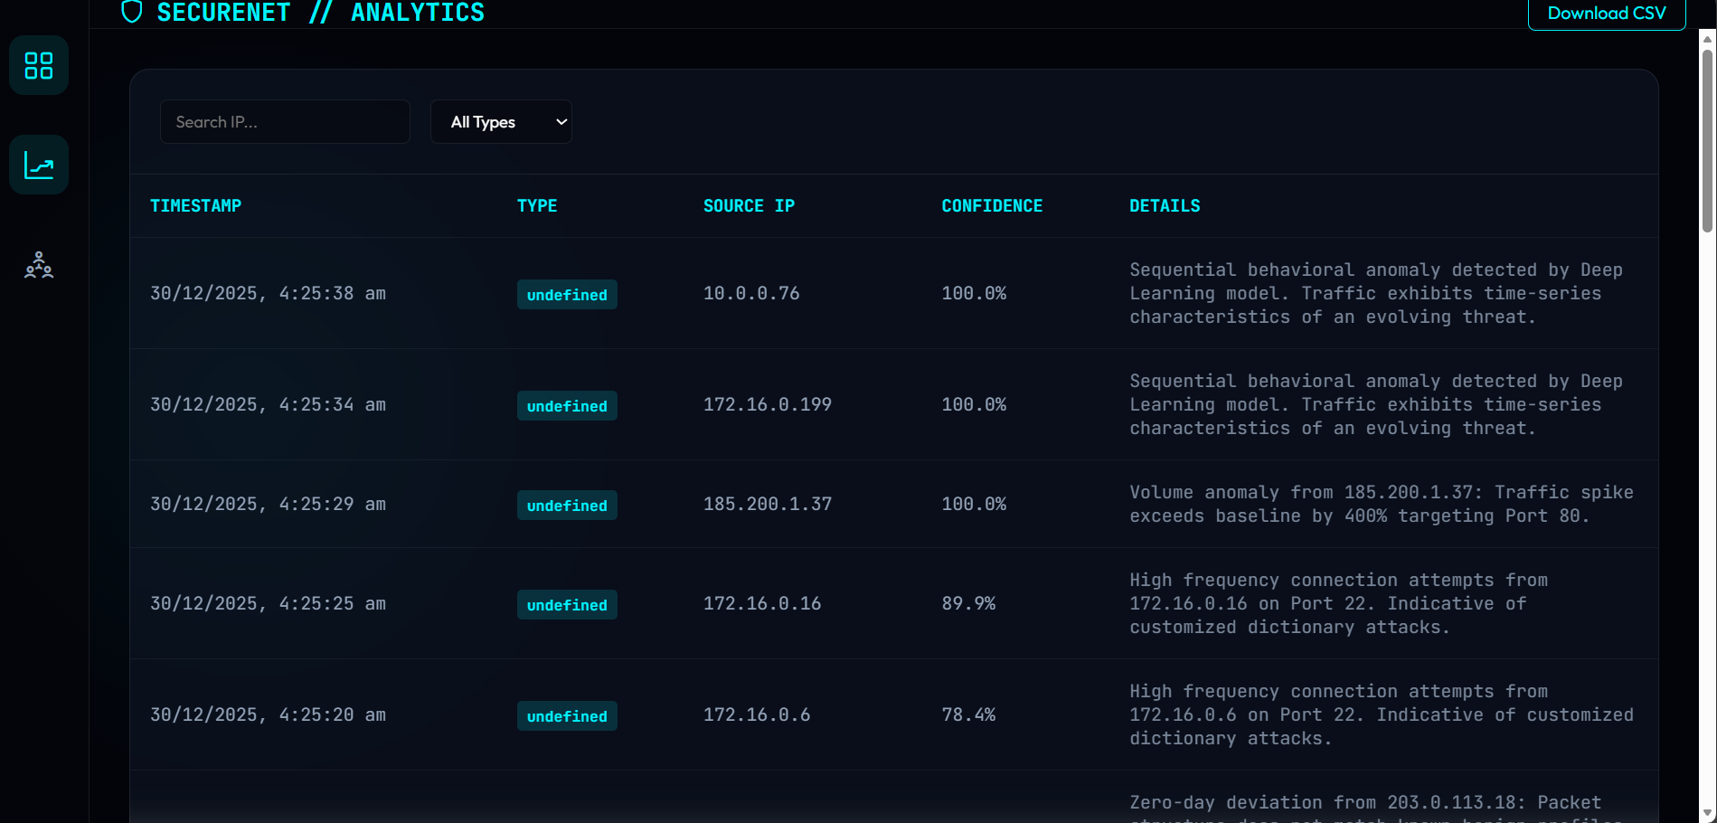
IMPLEMENTATION SCREENSHOTS
Fig 7.2.9 Quarantined and Blocked addresses
Fig 7.2.10 Analytics Page for downloading the list of attack file

Slide 43
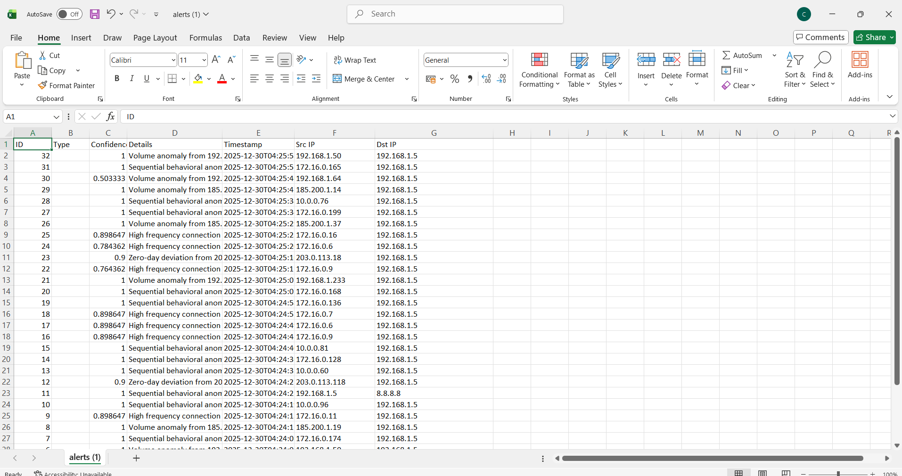
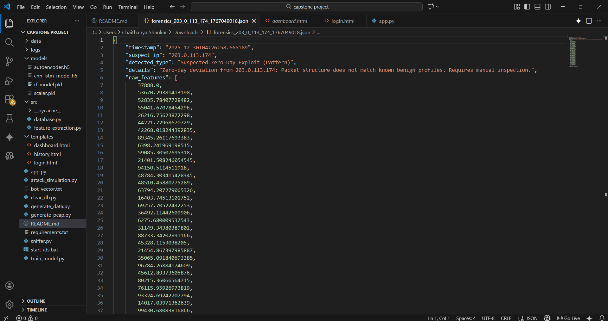
IMPLEMENTATION SCREENSHOTS
Fig 7.2.12 Json file that contains Forensic report of the Zero-day attack
Fig 7.2.11 CSV file that Contains Detected Attacks

Slide 44
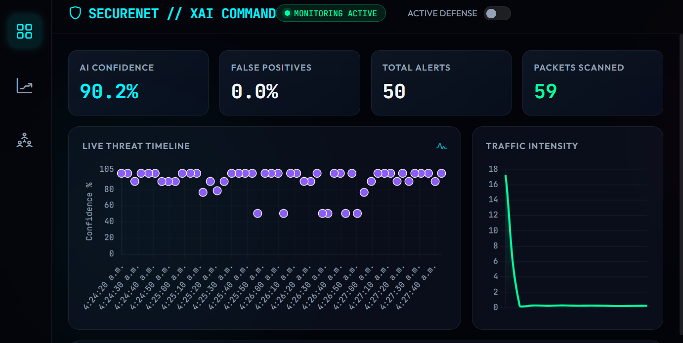
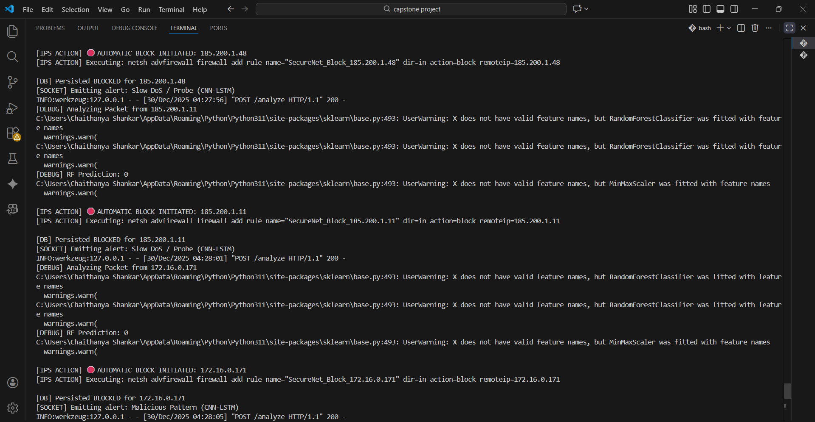
IMPLEMENTATION SCREENSHOTS
Fig 7.2.14 Terminal that also shows which IP addresses are blocked when the attack is detected
Fig 7.2.13 Bubble chart of the attacks detected in a span of time

Slide 45
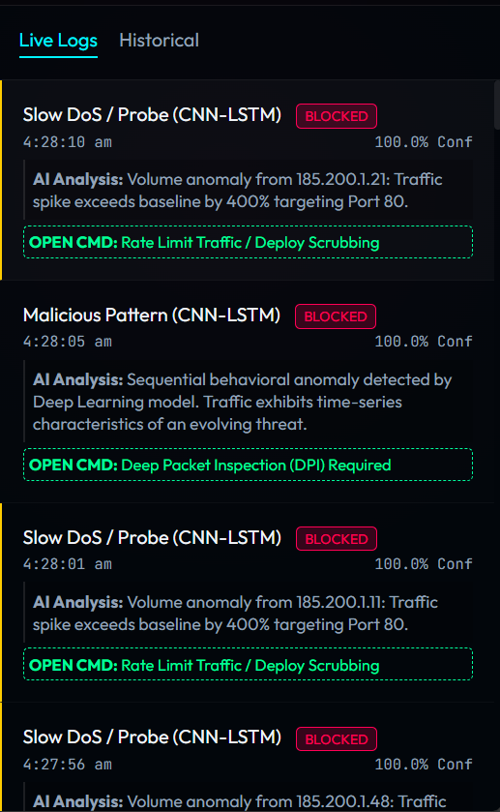
IMPLEMENTATION SCREENSHOTS
Fig 7.2.15 terminal of attack_simulation.py
Fig 7.2.16 Live Logs of attacks with XAI

Slide 46
REFERENCES
[1] Gala, Y., Vanjari, N., Doshi, D. and Radhanpurwala, I., 2023, March. AI based techniques for network-based intrusion detection system: A review. In 2023 10th International Conference on Computing for Sustainable Global Development (INDIACom) (pp. 1544-1551). IEEE.
[2] Reddy, V., Sunitha, R., Anusha, M., Chaitra, S. and Kumar, A.P., 2024, December. Artificial Intelligence Based Intrusion Detection Systems. In 2024 4th International Conference on Mobile Networks and Wireless Communications (ICMNWC) (pp. 1-6). IEEE.
[3] Sur, G., Kim, H., Yoon, S. and Lim, H., 2023, December. Development of AI-based Intrusion Detection System with Real-Time Flow Feature Extraction. In 2023 IEEE International Conference on Big Data (BigData) (pp. 6289-6291). IEEE.
[4] Bagmar, V. and Joshi, D., 2025, June. AI-Driven Real-Time Network Intrusion Detection using Machine Learning and Deep Learning. In 2025 3rd International Conference on Self Sustainable Artificial Intelligence Systems (ICSSAS) (pp. 1569-1574). IEEE.

Slide 47
REFERENCES
[5] Chen, J.L., Chen, Z.Z., Chang, Y.S., Li, C.I., Kao, T.I., Lin, Y.T., Xiao, Y.Y. and Qiu, J.F., 2023, February. AI-Based intrusion detection system for secure AI BOX applications. In 2023 International Conference on Artificial Intelligence in Information and Communication (ICAIIC) (pp. 360-364). IEEE.
[6] Park, C., Lee, J., Kim, Y., Park, J.G., Kim, H. and Hong, D., 2022. An enhanced AI-based network intrusion detection system using generative adversarial networks. IEEE Internet of Things Journal, 10(3), pp.2330-2345.
[7] Kim, A., Park, M. and Lee, D.H., 2020. AI-IDS: Application of deep learning to real-time Web intrusion detection. Ieee Access, 8, pp.70245-70261.
[8] Sharma, A., Chaudhari, B.B. and Kabade, S., 2025, July. Artificial Intelligence-Powered Network Intrusion Detection System (IDS) with Hybrid Deep Learning Approach in Cloud Environments. In 2025 IEEE North-East India International Energy Conversion Conference and Exhibition (NE-IECCE) (pp. 1-6). IEEE.
[9] Kipongo, J., Swart, T.G. and Esenogho, E., 2023. Artificial intelligence-based intrusion detection and prevention in edge-assisted SDWSN with modified honeycomb structure. IEEE access, 12, pp.3140-3175.

Slide 48
REFERENCES
[10] https://ieeexplore.ieee.org/Xplore/home.jsp
[11] Canadian Institute for Cybersecurity (CIC), "Intrusion Detection Evaluation Dataset (CICIDS2017)," University of New Brunswick

Slide 49
THANK YOU!

